Slide 1

Course Structure
Overview
Key Design Areas
Postings
FI Reporting - Standard G/L Reports in S/4HANA
Reporting
Finance CDS Views
Currencies in FI Reports
Make the Right Choice of FI Reports

Slide 2

Currency Display in Financial Reports - Overview
Currency
Key
Currency
Long Name
Currency
Short Name
Alternative Currency Name(s) *
00
Document Currency
DC
Transaction Currency
10
Company Code Currency
LC1
Local Currency
30
Group Currency
LC2
Local Currency 2,
Global Currency
31
Group Currency / Group Valuation
LC3
Free Defined Currency 1
When looking for the Currency related fields in SAP Financial Reports, remember the following:
* The field / column name representing the same Currency Type in different types of reports may be slightly different due to the way different reports are constructed.
SAP usually shows a shortened column name when a column is not displayed at its full width. You may hoover your mouse over or extend the width of the column to see its full name.
You may see additional currency fields / columns in some reports which are not listed here. Those currency types are not used in JTI.

Slide 3
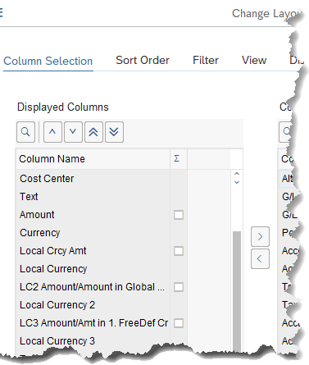
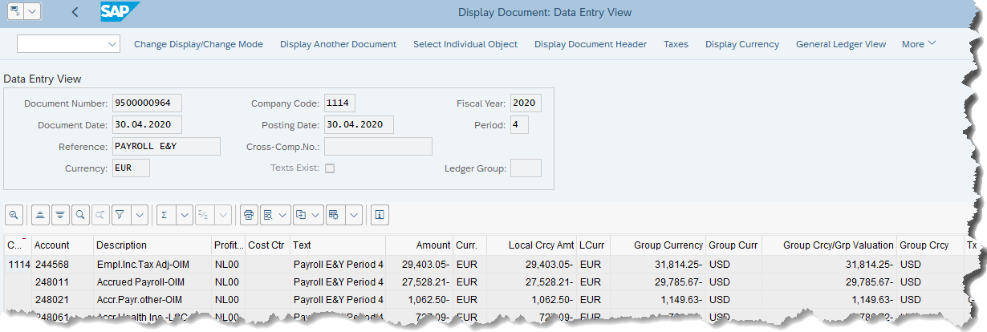
Currency Display – FI Document (FB03)
Change Layout
DC
LC1
LC2
LC3

Slide 4
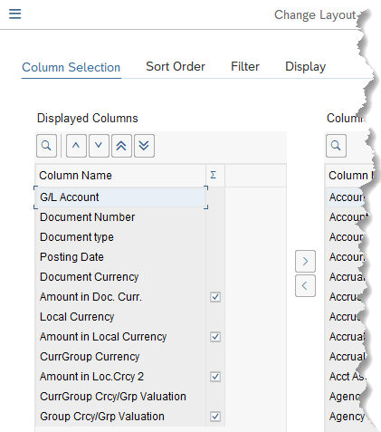
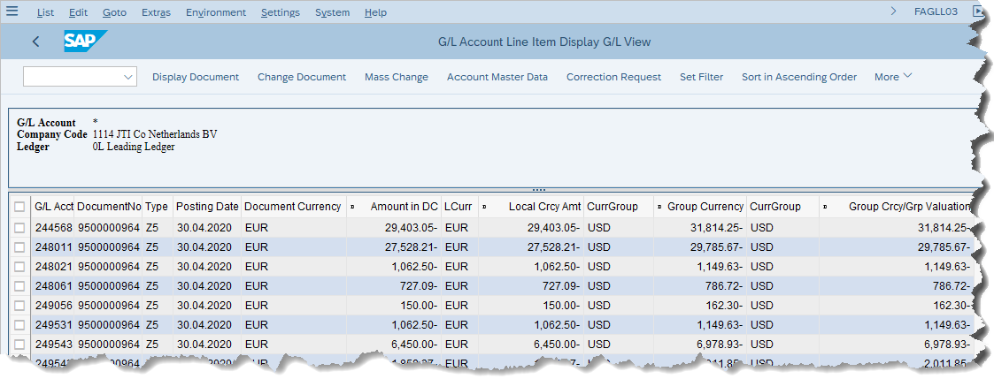
Currency Display – G/L Line Item (FAGLL03)
DC
LC1
LC2
LC3

Slide 5
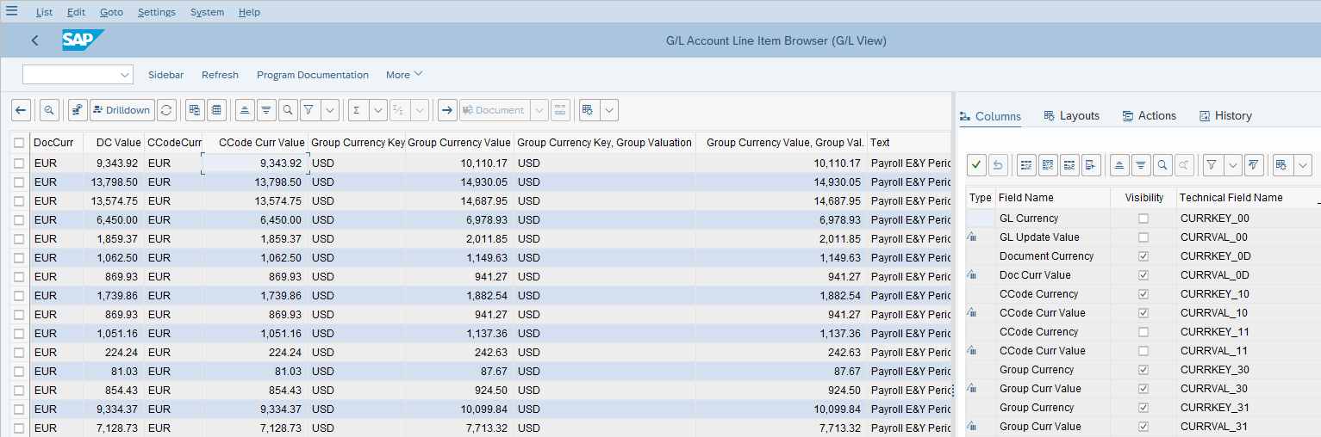
Currency Display – G/L Line Item Browser (FAGLL03H)
DC
LC1
LC2
LC3

Slide 6
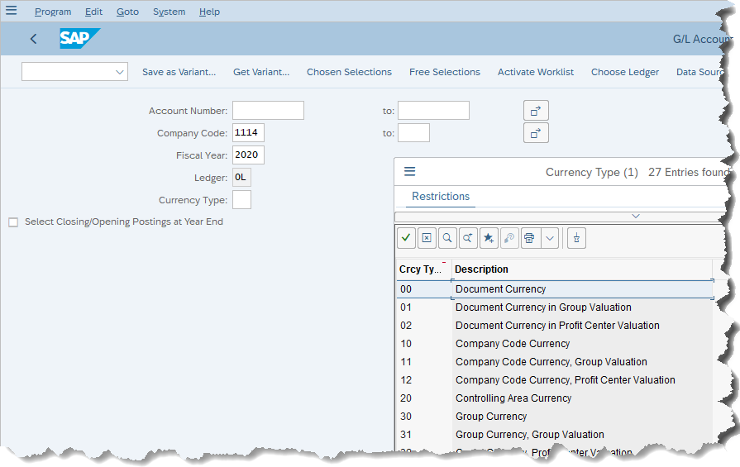
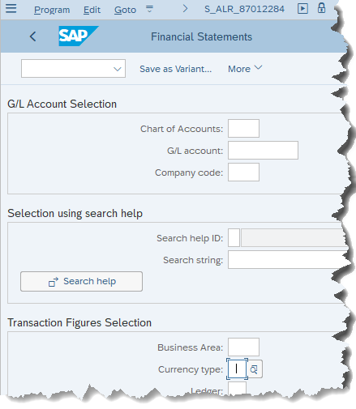
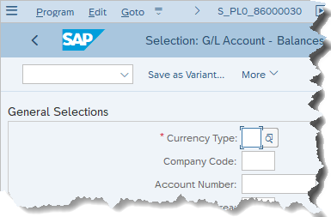
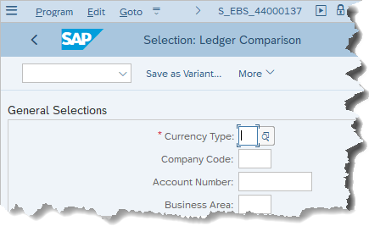
Currency Display – G/L Balance Reports (FAGLB03 / S_ALR* / S_EBS* / S_PL0*)
FAGLB03
Only selected Currency Types, instead of all, are displayed in the aggregated Financial Reports, i.e. the account balance reports in various summarized forms.
You select the required Currency Type (e.g. 00, 10, 30 or 31) from the drop-down list. Do not select the ones which are not used in JTI.

Slide 7
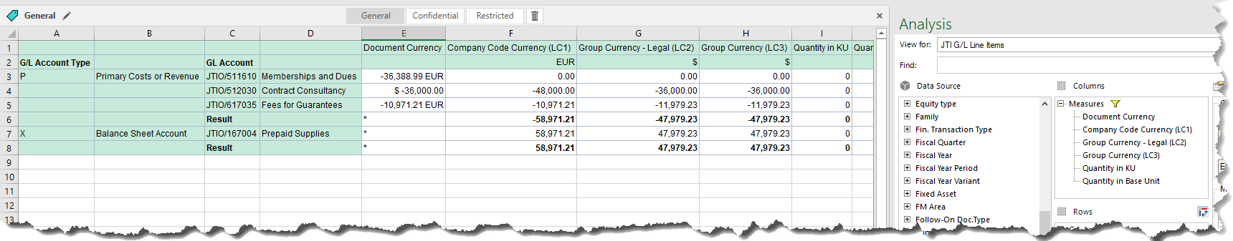
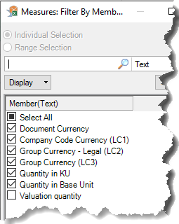
Currency Display – Finance CDS Views
The Currency Types and amounts for each Currency Type are usually configured as a “Measures” in Finance CDS Views reports, which are run via SAP Analysis for Office.
These Currency Keys are all clearly named and indicated as DC, LC1, LC2, or LC3.

